Slide 1
Lecture 2: Describing Your Data
Jibo He, Ph.D.
Associate Professor
Wichita State University
jibo.he@Wichita.edu

Slide 2
Review from the last lecture
Variable
Discrete vs. Continuous
Independent vs. dependent
Data
Population vs. Sample
Descriptive vs. Inferential statistics
Level of measurement

Slide 3
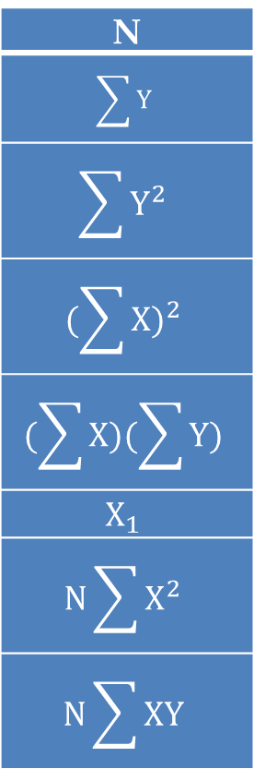
In-Class Exercise 1
Given this data set, compute the following quantities
N
$$\sum{Y}$$
$$\sum{Y^{2}}$$
$${(\sum{X})}^{2}$$
$$(\sum{X})(\sum{Y})$$
$$X_{1}$$
$$N\sum{X^{2}}$$
$$N\sum{XY}$$
Data Set
Subject | X | Y
1 | 5 | 6
2 | 3 | 9
3 | 2 | 7
4 | 0 | 6
5 | 8 | 2
6 | 1 | 5

Slide 4
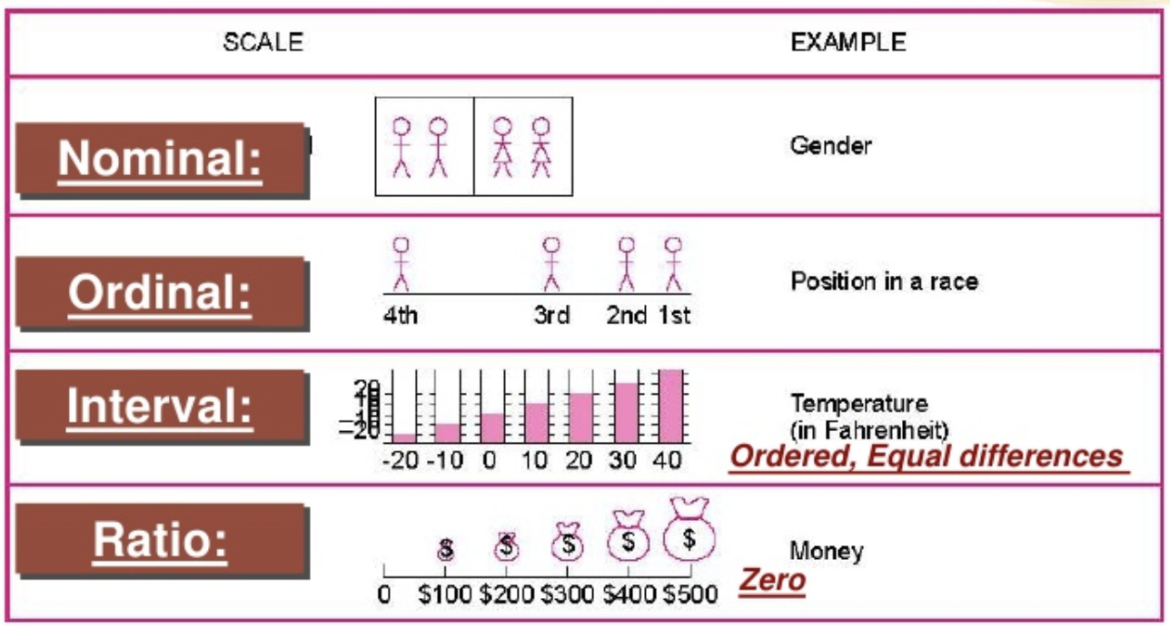
Level of Measurement

Slide 5
In-Class Exercise 2
Variable | Nominal | Ordinal | Interval | Ratio
1. Highest temperature for each day in September (in degrees Fahrenheit)
2. Satisfaction ratings from a customer service call center on a 7-point scale, where 7 = very satisfied and 1 = very unsatisfied
3. Political party affiliation
4. The time it takes an athlete to run a mile
5. Rankings of most popular television shows
6. Personal income of employees at a company
7. The calendar year in which a person was born
8. Meal preferences for passengers on an airplane

Slide 6
In-Class Exercise 2
Variable | Nominal | Ordinal | Interval | Ratio
1. Highest temperature for each day in September (in degrees Fahrenheit) |  |  | X
2. Satisfaction ratings from a customer service call center on a 7-point scale, where 7 = very satisfied and 1 = very unsatisfied |  | X | X
3. Political party affiliation | X
4. The time it takes an athlete to run a mile |  |  |  | X
5. Rankings of most popular television shows |  | X
6. Personal income of employees at a company |  |  |  | X
7. The calendar year in which a person was born |  |  |  | X
8. Meal preferences for passengers on an airplane | X

Slide 7
In-Class Exercise 2
Variable | Nominal | Ordinal | Interval | Ratio
9. Speed settings on a fan (listed as low, medium, and high)
10. Ages of students beginning college
11. Species of birds present in the rainforest
12. Altitudes of mountains and valleys in North America expressed in number of feet above or below sea level
13. Eye colors of newborn babies
14. Weights of people currently dieting
15. SAT scores for incoming freshmen

Slide 8
In-Class Exercise 2
Variable | Nominal | Ordinal | Interval | Ratio
9. Speed settings on a fan (listed as low, medium, and high) |  | X
10. Ages of students beginning college |  |  |  | X
11. Species of birds present in the rainforest | X
12. Altitudes of mountains and valleys in North America expressed in number of feet above or below sea level |  |  |  | X
13. Eye colors of newborn babies | X
14. Weights of people currently dieting |  |  |  | X
15. SAT scores for incoming freshmen |  |  | X

Slide 9
Additional Concepts
Theory world
Population→ Parameter
Data world
Sample→ Statistic

Slide 10
Organizing Data
Frequency Table
30 students

Slide 11
Histogram
Show frequency distribution
Note: Use Histogram to note patterns in data. (Skew, etc.)

Slide 12
Histogram
How to draw histogram
Divide the data into intervals of equal size
Compute the grouped frequencies
Number of scores that fall within an interval
Drawing the Histogram
Frequencies are plotted on the Y-axis
Scores on the variable are on the X-axis

Slide 13
Frequency Polygon
Time Awake | Number of Students (Frequency) | Relative Frequency
6:30-7:00 | 1 | 0.0333
7:00-7:30 | 1 | 0.0333
7:30-8:00 | 3 | 0.1
8:00-8:30 | 2 | 0.0667
8:30-9:00 | 4 | 0.1333
9:00-9:30 | 5 | 0.1667
9:30-10:00 | 7 | 0.2333
10:00-10:30 | 4 | 0.1333
10:30-11:00 | 3 | 0.1
Total | 30 | 1

Slide 14
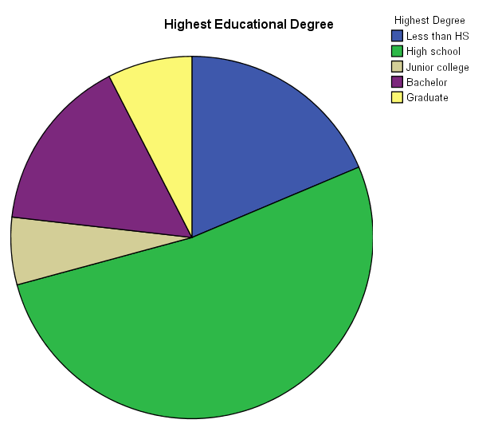
Pie Chart (for categorical data)
Notes:
Message we have from this pie chart

Slide 15
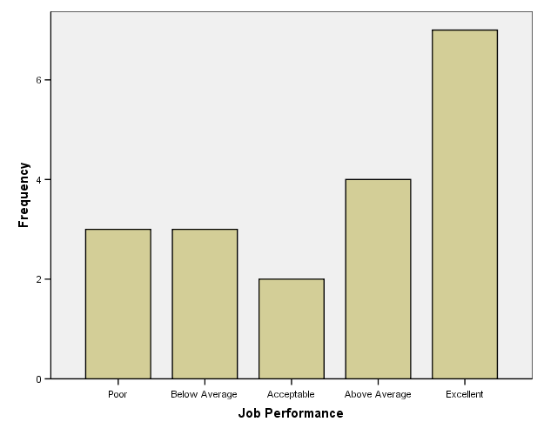
Bar Graph (for categorical data)

Slide 16
Descriptive Statistics
Central Tendency
Mode
Median
Mean
Spread
Range
Deviations from the mean
Mean deviation
Variability/Standard deviation

Slide 17
Mode
Most frequent observation in your data
There can be several distinct modes
“Best guess” in single shot guessing game

Slide 18
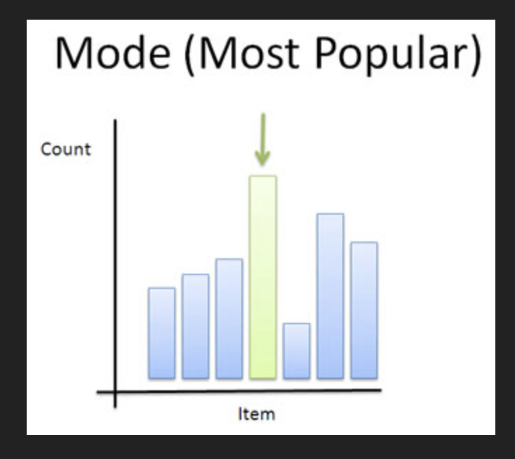
Mode

Slide 19
Mode (example data)
Mode?
9:30

Slide 20
Median
Definition: Any value M for which at least 50% of all observations are at or above M and at least 50% are at or below M.
Resistant measure of central tendency (not heavily influenced by extreme values)

Slide 21
Calculating the Median
Order all observations from smallest to largest.
If the number of observations is odd, it is the “middle” object, namely the [(n+1)/2]th observation.
For n = 61, it is the 31st
If the number of observations is even then, to get a unique value, take the average of the (n/2)th and the (n/2 +1)th observation.
For = 60, it is the average of the 30th and the 31st observation.

Slide 22
Median (example data)
Since there are an even number of data points
Take the average of the middle two values.
,

Slide 23
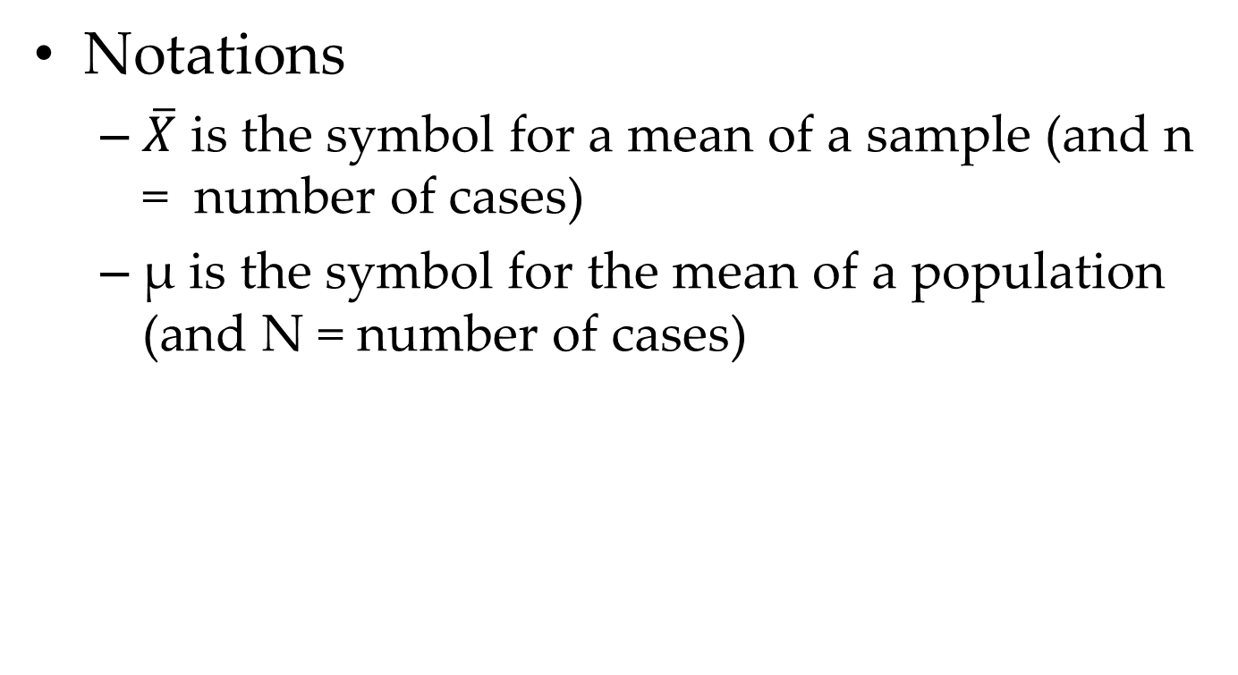
Mean
Notations
$\overline{X}$ is the symbol for a mean of a sample (and n = number of cases)
µ is the symbol for the mean of a population (and N = number of cases)
Notes:
Skewed distribution, the position of mean, median, and mode?

Slide 24
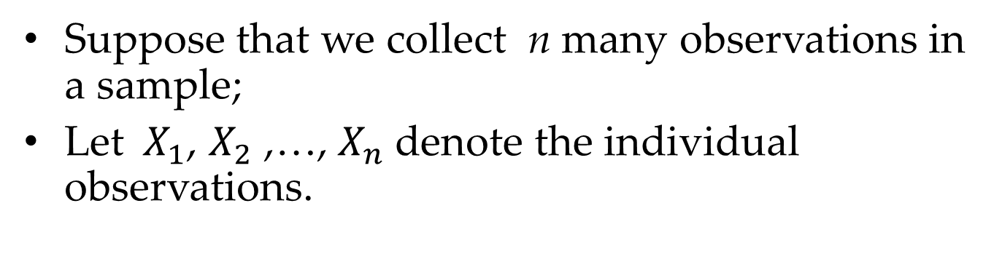
Calculating the mean
Suppose that we collect n many observations in a sample;
Let${ X}_{1}$, $X_{2}$ ,…, $X_{n}$denote the individual observations.
Mean
Sum up all observations (say, n many)
and divide the total by n.
Mean

Slide 25
Properties of the “mean”
If all data has the same value, a,
then the mean value is also a.
because:
Mean

Slide 26
Multiplying all values by a constant

Slide 27
If we multiply each observation
by 2, then we obtain a new
distribution with a different shape
A multiplying constant
affects the mean
(and the “spread”)

Slide 28
Adding a constant to all values

Slide 29
If we add the constant 5
to each observation,
then we obtain a new
distribution that is shifted
to the right by 5 units
A shift affects the mean
(but not the “spread”)

Slide 30
Combining two variables

Slide 31
Adding two variables
The mean of the sum of two variables
is the sum of their means

Slide 32
Caution!
Extreme values strongly influence the mean!

Slide 33
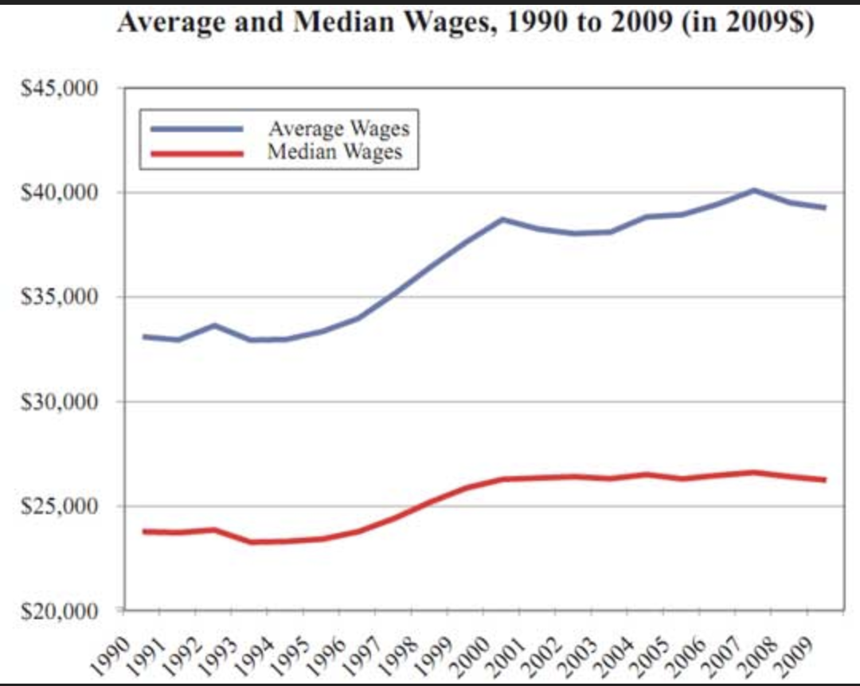
Example: Median versus Mean
Which is more influenced by outliers or extremes?
US median and mean salary

Slide 34
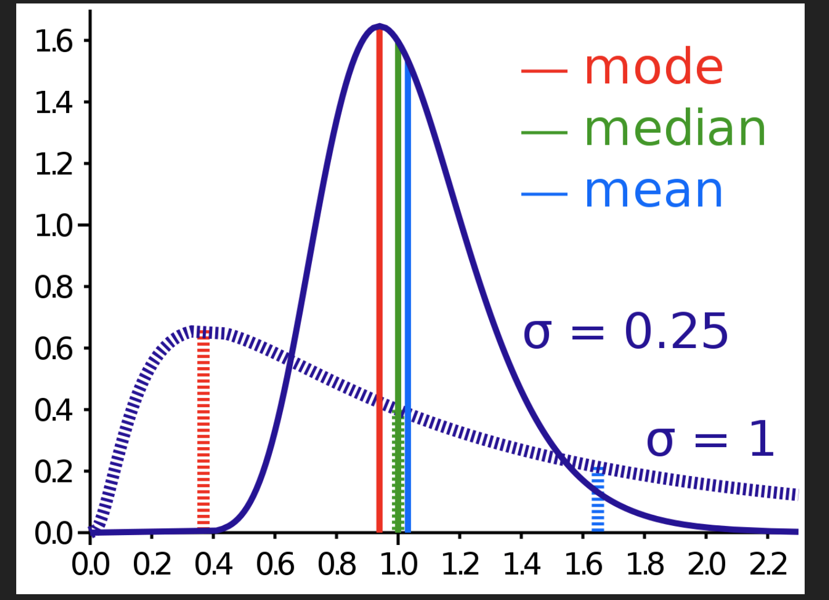
Compare mode, median, mean

Slide 35
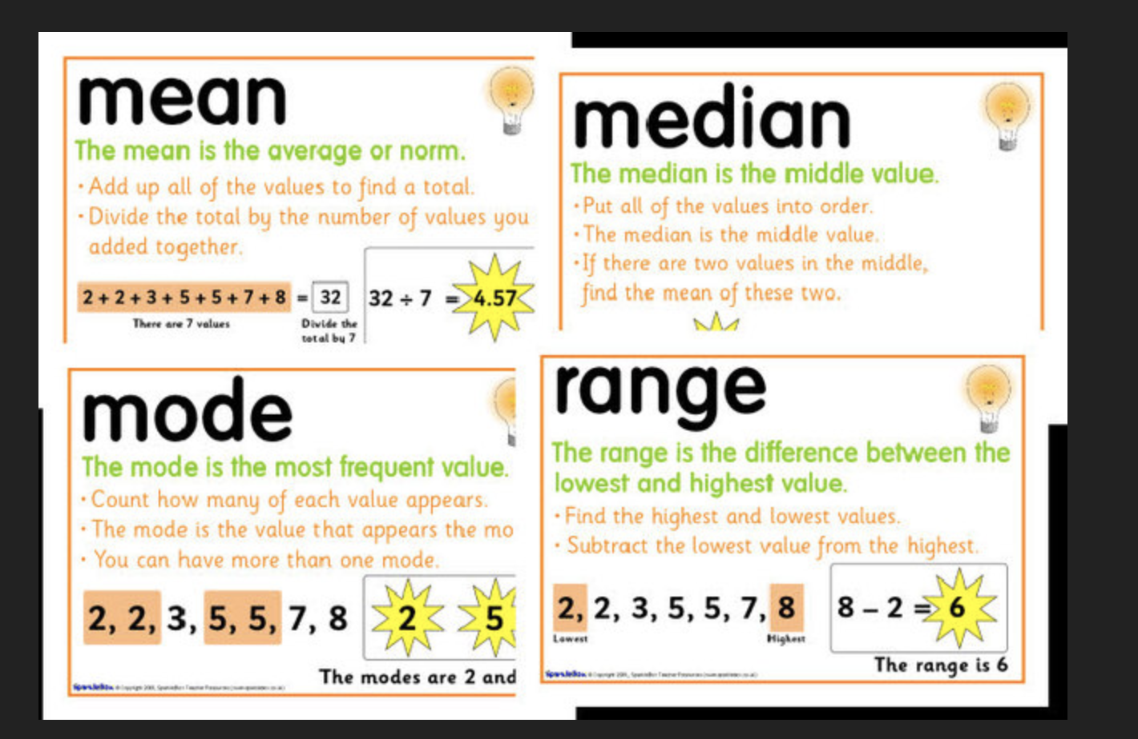
Compare mode, median, mean

Slide 36
Exercise in R
#install.packages("psych")
library(psych)
# assign data values
values <- c(1, 2, 3, 4)
# item name ,item number, nvalid, mean, sd, # median, mad, min, max, skew, kurtosis, se# this require the psych package
describe(values)
# mean,median,25th and 75th quartiles,min,max
summary(values)

Slide 37
Summary of Knowledge
Level of measurement
Incremental Progress | Measure Property | Mathematical Operators | Advanced Operations | Central Tendency
Nominal | Classification, Membership | =, != | Grouping | Mode
Ordinal | Comparison, Level | >, < | Sorting | Median
Interval | Difference, Affinity | +, - | Yardstick | Mean,Deviation
Ratio | Magnitude, Amount | *, / | Ratio | Geometric Mean,Coeff. of Variation
Source: https://en.wikipedia.org/wiki/Level_of_measurement

Slide 38
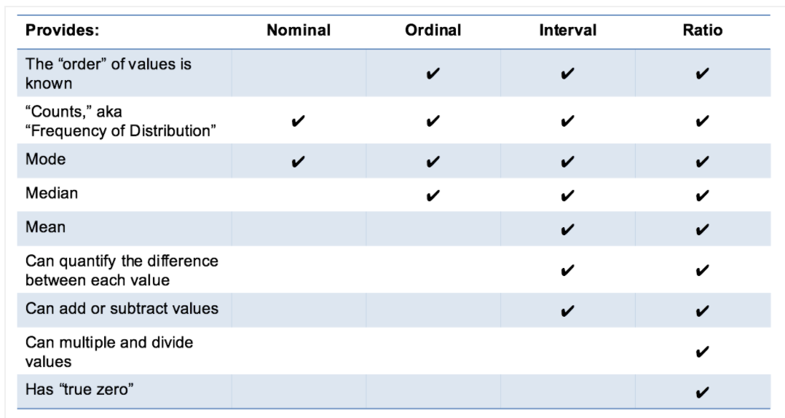
Summary of Knowledge
Level of measurement
Notes:
http://www.mymarketresearchmethods.com/types-of-data-nominal-ordinal-interval-ratio/

Slide 39
Descriptive Statistics
Central Tendency
Mode
Median
Mean
Spread
Range
Deviations from the mean
Mean deviation
Variability/Standard deviation

